Slide 1
Structure

Slide 2
Purpose
The purpose of the structure is to collect items from different types, therefore improving the neatness and organization of the program

Slide 3
Basic Example
struct inflatable // structure declaration
{
char name[20];
float volume;
double price;
};

Slide 4
Example (Cont’d)
You can declare the following after the structure is formed
inflatable vase;
inflatable hat;
And so on
Example in the next page explains how to initialize structure variable also

Slide 5
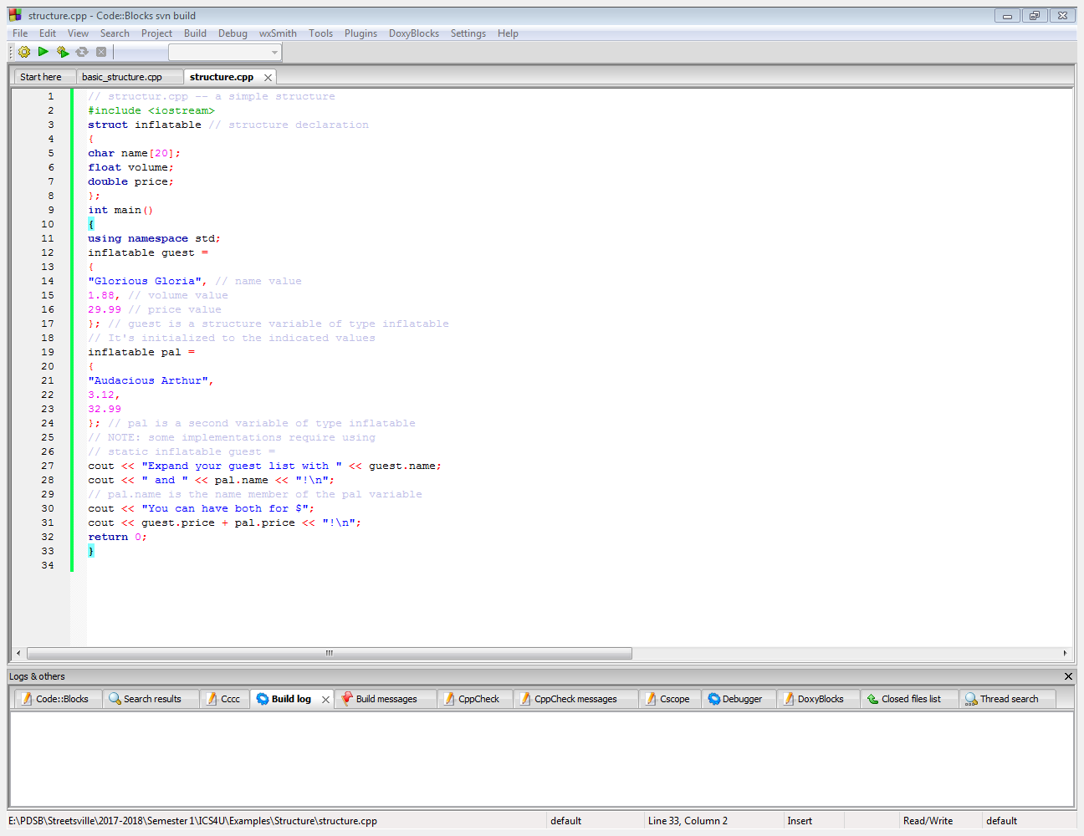
program

Slide 6
Reminder
Make sure to use “.” for each different value in the structure
More example in the next page

Slide 7
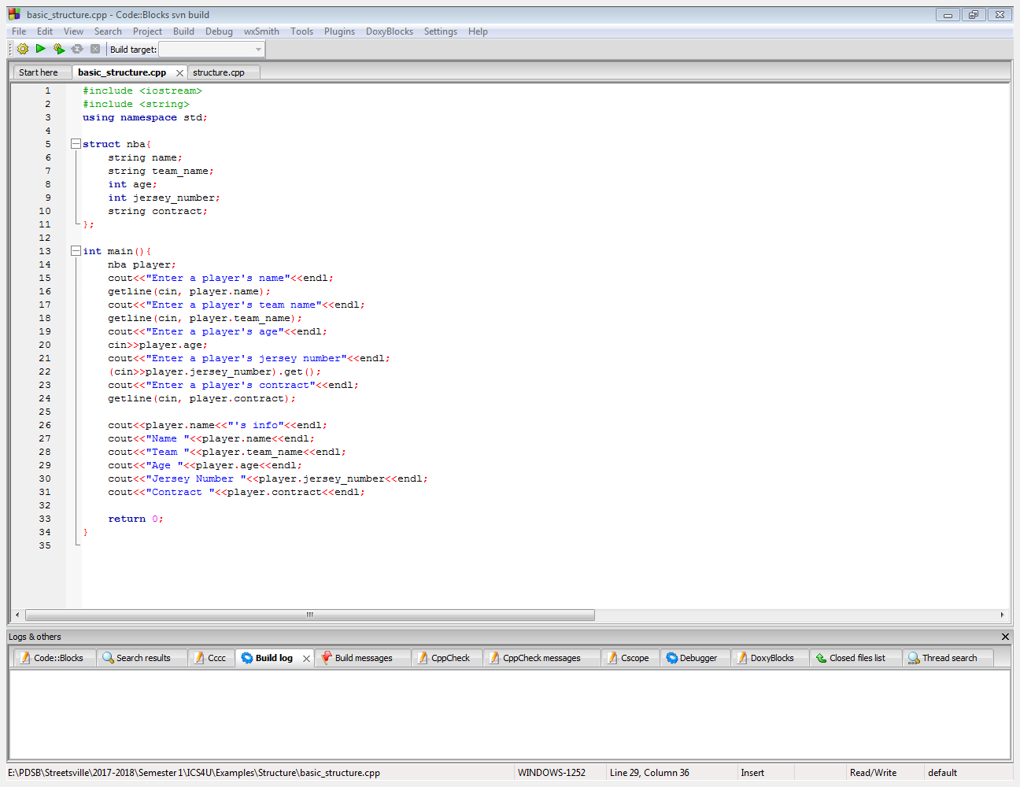

Slide 8
Array of structure
You can also create an array of structure:
Example in the next slide

Slide 9
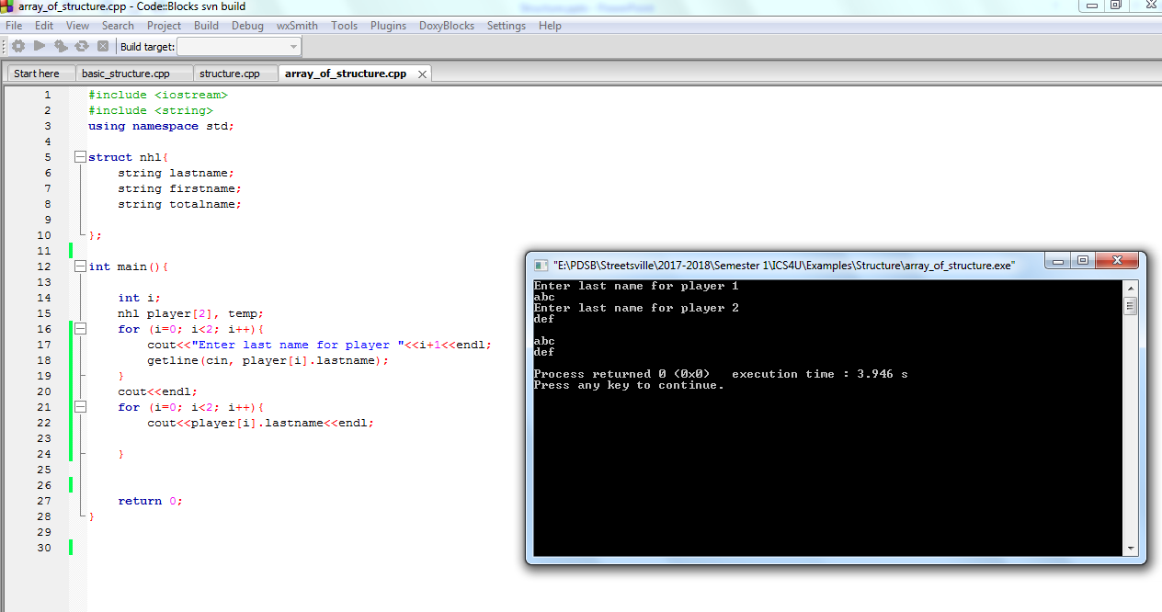

Slide 10
Tips in Structure
1. Structure can be copied!
In the previous example, we have the structure named temp
Should we make temp=player[0], it will copy everything from player[0] to temp!
Example in the next slide

Slide 11
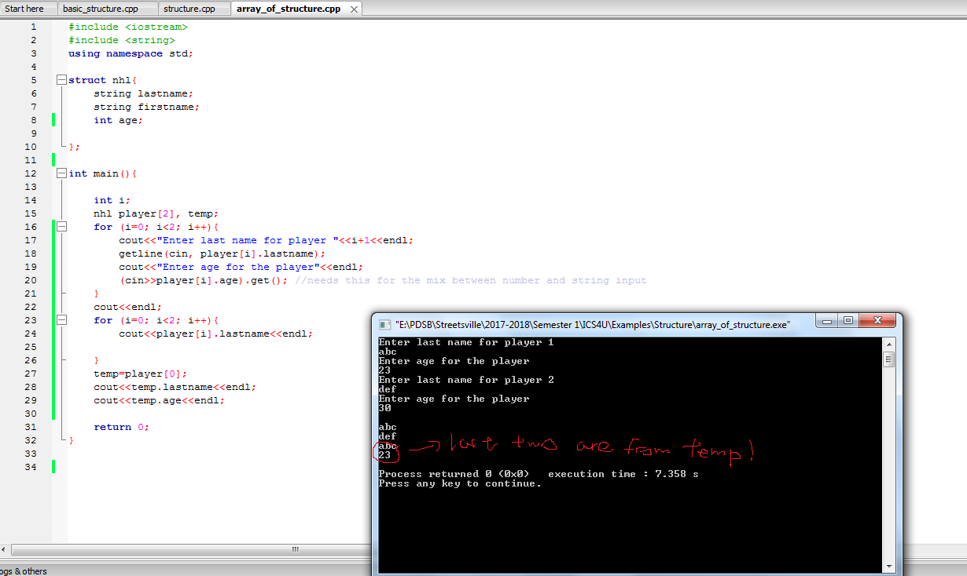

Slide 12
Tips (more)
When passed structure into the function, normally it’s passed by value
So another copy of the structure will be made, therefore you need to return a structure, as the original structure will not be modified
(There is a way to get around this→ with pointers, or passing by reference Example in the next slide

Slide 13
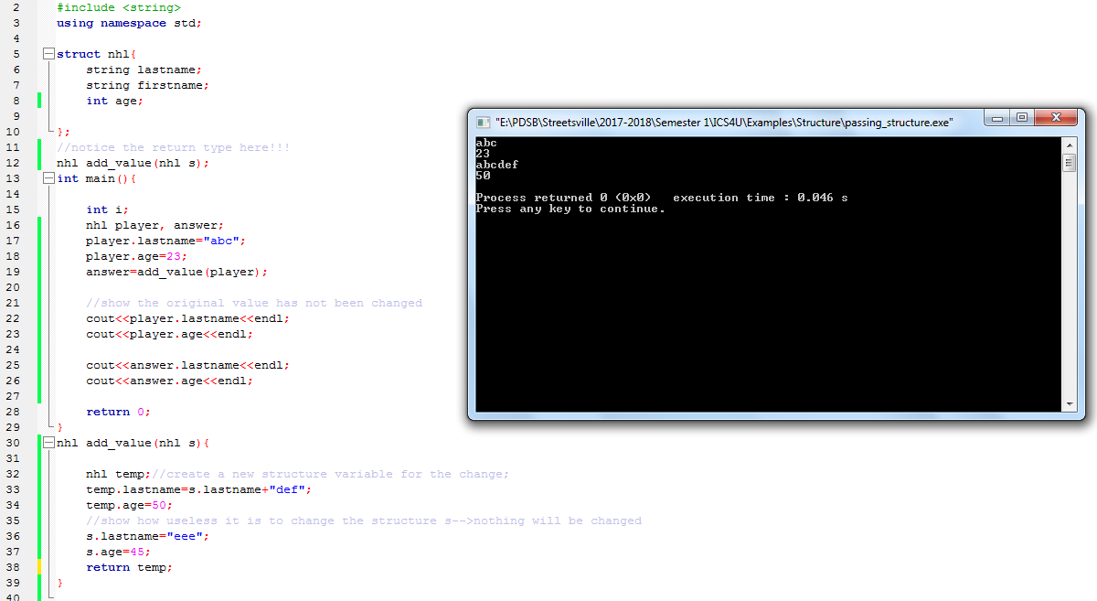

Slide 14
Tips (#3)
When you are passing array of structure, however, the original structure will get modified, so you can use void as you don’t have to return anything
Example in the next slide

Slide 15
